Slide 1
Lighting up and powering Africa with the African Development Bank
A quick overview

Slide 2
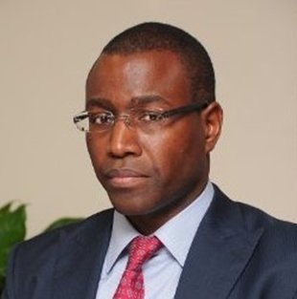
Hello!
I am Amadou Hott
Vice President Vice-President, Power, Energy, Climate and Green Growth

Slide 3
Presentation outline
The Bank’s Strategy for the New Deal on Energy for Africa
Africa’s renewable energy potential and operations supported by the African Development Bank
African Development Bank special instruments and initiatives in renewable energy
2018 Outlook: renewable energy projects and initiatives

Slide 4
Africa’s energy needs are critical and urgent
588 millions Africans live without access to electricity – the bulk live in Sub-Saharan Africa.
Energy sector bottlenecks cost the continent 2-4 % GDP annually.
The continent cannot develop in the dark.

Slide 5
African Development Bank launched the New Deal on Energy for Africa in 2016
Lighting up and powering Africa is the first of the Bank’s High-5 priorities.
Bank has launched New Deal on Energy for Africa to achieve universal access by 2025:
160 GW on-grid generation,
130 million new on-grid connections,
75 million new off-grid connections,
150 million households with access to clean cooking solutions.

Slide 6
The private sector has an important role to play in achieving the New Deal targets
Achieving the New Deal on Energy for Africa requires a significant increase of private sector investments.
Sovereign and non-sovereign operations under one Vice-Presidency to enable leveraging of public resources to attract private sector investments.
In 2017, Bank’s private sector lending in support of energy projects reached almost USD 400 million – which represent a 40% increase from the previous year.

Slide 7
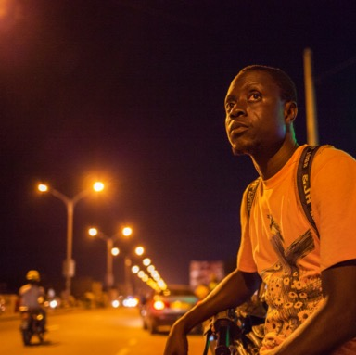
In terms of impact, projects approved by the African Development Bank since the launch of the New Deal (2016 and 2017) will contribute towards:
2 GW additional capacity, essentially from renewable energy sources.
3,340 km of transmission lines (of which 2,580 km of regional interconnections) along with 24,300 km of distribution lines and associated/substations transformers.
1.5 million direct electricity connections which will provide electricity to around 7.1 million additional persons.
10,600 jobs created during construction phase and 1,000 during maintenance phase.

Slide 8
Presentation outline
The Bank’s Strategy for the New Deal on Energy for Africa
Africa’s renewable energy potential and operations supported by the African Development Bank
African Development Bank special instruments and initiatives in renewable energy
2018 Outlook: renewable energy projects and initiatives

Slide 9
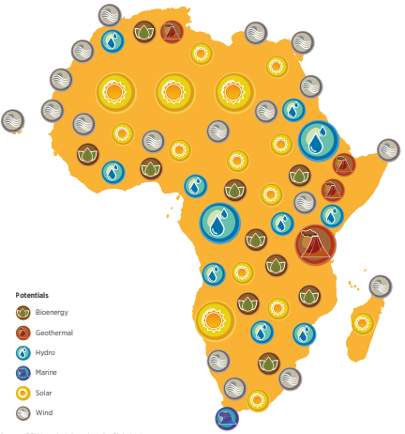
Africa has an immense renewable energy potential
The International Renewable Energy Agency (IRENA) estimates the cost-effective potential for renewable energy in Africa at 310 GW by 2030 and tapping this potential would require an annual investment of USD 32 billion for renewables generation capacity.
Distribution of identified renewable energy potential in Africa (Source: IRENA)

Slide 10
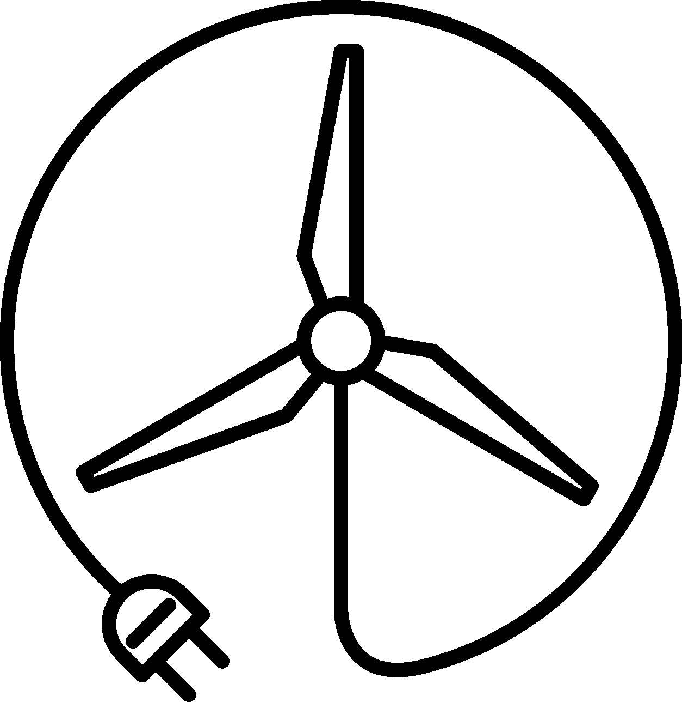
The African Development Bank’s interventions cover all facets of renewable energy
Utility-scale renewable energy generation | 800 MW Midel Solar Complex in Morocco (approved in 2017). Nachtigal 400 MW Hydro Power Plant in Cameroon (approved 2017.
Off-grid and mini-grid | Technical assistance to address barriers to scaling-up of private sector mini-grids and solar home systems (e.g. GMG-MDP, Pilot TA in Togo in 2018). Financing of private sector investors (e.g. Pilot Receivables financing off-grid project in 2018).
Investments in private equity and debt funds | The Facility for Energy Inclusion (FEI) for which the Bank approved a USD 100 million anchor investment to close funding gaps in the small-scale energy infrastructure sector and catalyze growth in last-mile energy access solutions.
Project preparation support | The Bank’s SEFA has approved 12 projects in 2017 that aim to bring additional 166 MW and leverage USD 340 million.
Transmission projects including crucial regional interconnectors that are critical to evacuate power generated from renewable energy | Cameroon-Chad Power Interconnection (approved in 2017). Guinea-Mali Power Interconnection (approved in 2017). Nigeria-Niger-Burkina Faso-Mali Power Interconnection (approved in 2017).

Slide 11
Selected renewable energy projects supported by the African Development Bank (1/3)
The Ouarzazate Solar Complex in Morocco for which the Bank has committed EUR 134 M as well as USD 219 M from the Clean Investment Funds (CIF) aims to produce 510 MW of solar power. The 160 MW first phase was inaugurated in 2016 while the second phase of 350 MW is under construction – which will make Ouarzazate one of the largest solar complexes in the world.
The 100 MW Xina concentrated solar IPP in South Africa – that has a storage component to help meet peak demand in the evening – is in commercial operation since 2017. In 2014, the AfDB has approved a senior loan of USD 100 M along with a senior loan of USD 41.5 M from the CIF.
The 33 MW Segou Solar IPP is Mali’s first utility-scale solar project. In 2016, the AfDB has approved a senior loan of USD 8.5 M along with a senior loan of USD 25 M from the Climate Investment Funds (CIF).

Slide 12
Selected renewable energy projects supported by the African Development Bank (2/3)
The Lake Turkana Wind Power Project in Kenya comprises a 300 MW Wind Farm IPP and a 428 km transmission line to connect the power station to the power grid constructed by the Government of Kenya. The AfDB provided an ADB loan of EUR 115 million as well as a EUR 20 million ADF Partial Risk Guarantee (PRG) to protect the power plant against the risk of the 428 km transmission line and substations construction delay
The 120 MW Itezhi-Tezhi Hydro Power Plant in Zambia was developed by a joint venture SPV equally owned by the Zambia Electricity Supply Company (ZESCO) and a private sponsor. The Bank has provided a mix of financing: the public sector funds (around USD 50 M) contributed to financing half of ZESCO’s equity participation in the SPV, provide technical assistance to ZESCO, as well as co-finance the 276 km transmission line to evacuate the power, while the ADB private sector funds provided a USD 38 senior debt to the SPV.

Slide 13
Selected renewable energy projects supported by the African Development Bank (3/3)
The 42 MW Achwa 2 IPP is a run-of-river hydro power plant in Uganda. In 2016, the AfDB has approved a senior loan of up to USD 20 M. The project has reached financial close end 2017 and commercial operations is expected over the new two year.
The initial development of Kenya’s Menengai steam field for which the AfDB has committed around USD 110 M as well as USD 25 M from the CIF in 2011, has the potential to produce steam for around 105 MW capacity. Kenya has selected the first group of IPPs that are working towards financial close by 2018. The Bank is also providing partial risk guarantees (PRGs) to backstop the obligations of the state-owned entities vis-à-vis the IPPs.

Slide 14
Presentation outline
The Bank Strategy for the New Deal on Energy for Africa
Africa’s renewable energy potential and operations supported by the African Development Bank
African Development Bank special instruments and initiatives in renewable energy
2018 Outlook: renewable energy projects and initiatives

Slide 15
The Facility for Energy Inclusion (FEI)
FEI is a debt financing platform that targets segments of the sector that remain underserved – small scale energy projects and products that fall below traditional minimum investments thresholds and are unfamiliar to investors. The Facility supports the emergence of the next generation of African energy service companies and projects.
FEI operates through two windows:
On-grid:
Small scale IPP’s, mini-grids and captive power projects
Off-grid:
PAYGO and other energy access product distribution companies

Slide 16
Sustainable Energy Fund for Africa (SEFA)
SEFA is designed to scale-up AfDB’s involvement in small and medium sized private-sector driven RE/EE projects, as a means of stimulating economic growth and job creation.
SCOPE
RESOURCE ENVELOPE
Component I - Project Preparation Grants
Preparation support to
RE/EE Projects
USD 25.2 million
Component II – Equity Investments
Africa Renewable Energy Fund (AREF)
USD 35.5 million
Component III – Enabling Environment
FINANCING INTRUMENT
MANAGEMENT
Grants up to USD 1 million to project developers
Seed/growth capital for RE Projects
Equity and TA through a Private Equity Fund
Enabling environment for private investments in RE
Grants for TA and capacity building of public actors
SEFA & Sustainable Energy for All
USD 34.7 million
SEFA

Slide 17
Presentation outline
The Bank’s Strategy for the New Deal on Energy for Africa
Africa’s renewable energy potential and operations supported by the African Development Bank
African Development Bank special instruments and initiatives in renewable energy
2018 Outlook: renewable energy projects and initiatives

Slide 18
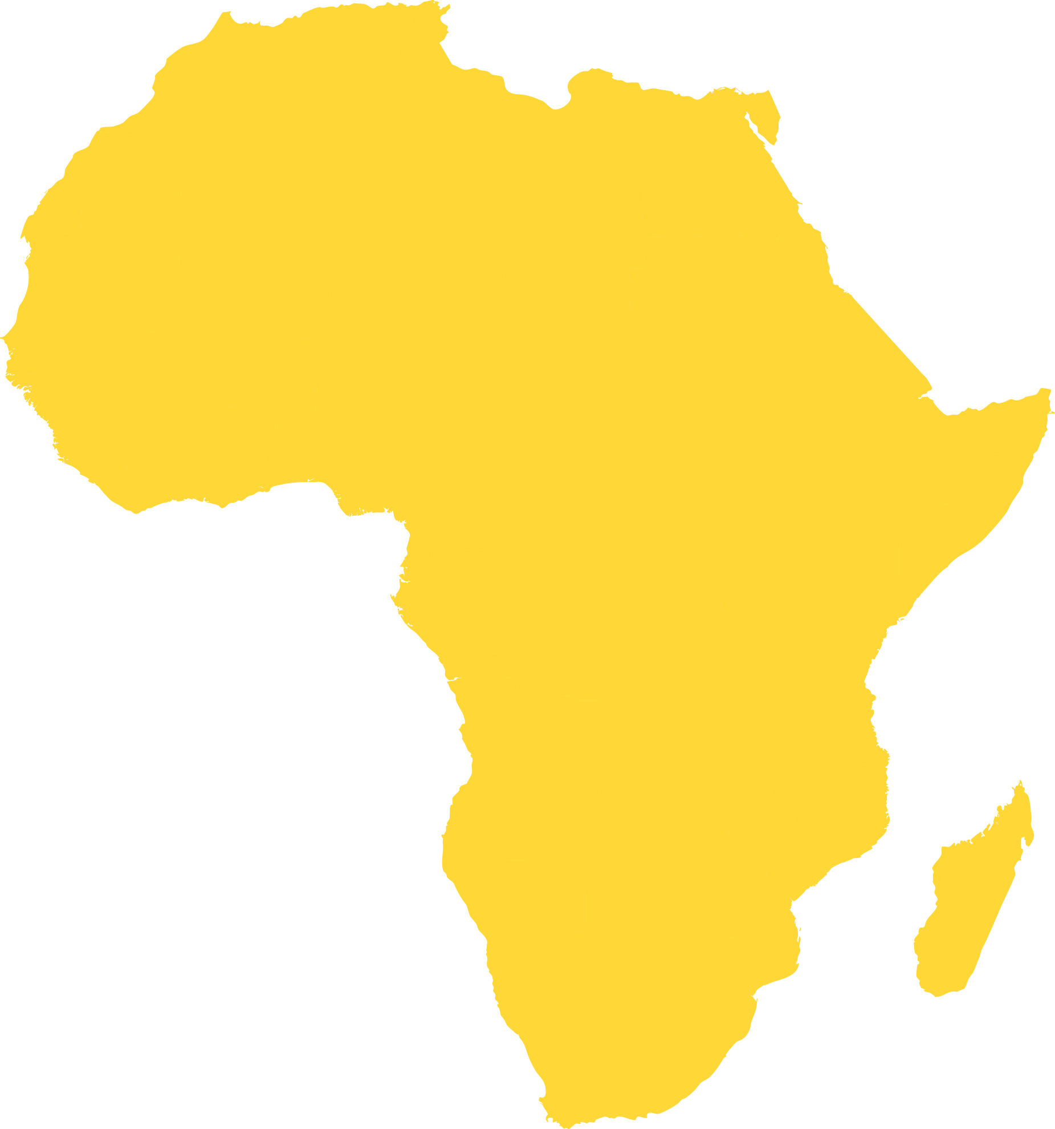
Selected operations expected to be supported by the African Development Bank
BURKINA FASO
Yeleen Solar Programme
CHAD
30 MW Solar PV Power Plant
First IPP and PPP in the country
CÔTE D’IVOIRE
Pay-As-You-Go Solar Home Systems
First large scale local currency solar assets receivables backed financing structure for the off-grid sector in Africa
KENYA
Menengai 35 MW Geothermal Power Plant
NIGERIA
50 to 100 MW Solar PV Power Plants
TANZANIA
Kanoko 87 MW Hydro Power Plant
ZAMBIA
Renewable Energy Financing Framework
Programmatic approach to scale up RE deployment
MADAGASCAR
200 MW Hydro Power Plant

Slide 19
Initiatives
Desert-to-power
Objectives: 10 GW additional capacity, energy access for 250 million people in 11 countries of the Sahel-Sahara region including 160 million people through on grid solutions and 90 million people though off-grid solutions
Implementation modalities: (i) Promotion of PPP best practices (Masen model); (ii) Increasing local content, promoting local development opportunities (solar for irrigation, water pumping, livestock); (iii) Building capacities via a regional solar school
Off-grid revolution
Support the development of green mini-grids and solar home systems through technical assistance & whole village electrification initiatives– e.g. pilot in Togo in 2018
Develop country-wide off-grid programmes
Finance DESCOs in target countries for instance through FEI
Build on Green Mini Grid Market Development Program
Financing of private sector investors – e.g. Pilot Receivables financing off-grid project in Côte d’Ivoire in 2018
Providing finance and exploring innovative finance instruments for DESCOs to grow and expand their business in new countries
Mobilizing climate finance
Leveraging technology to set up “evaluation as you go” desk

Slide 20
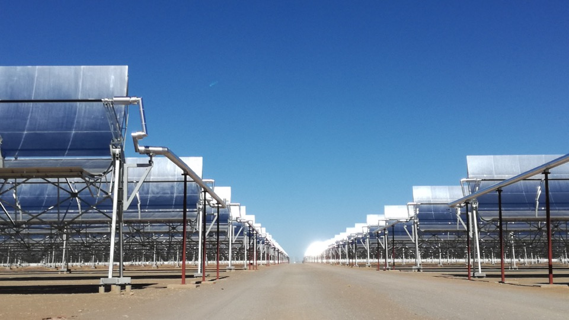
Thank you.

