Slide 1
Partnering and Investing with the African Development Bank
February 2018

Slide 2
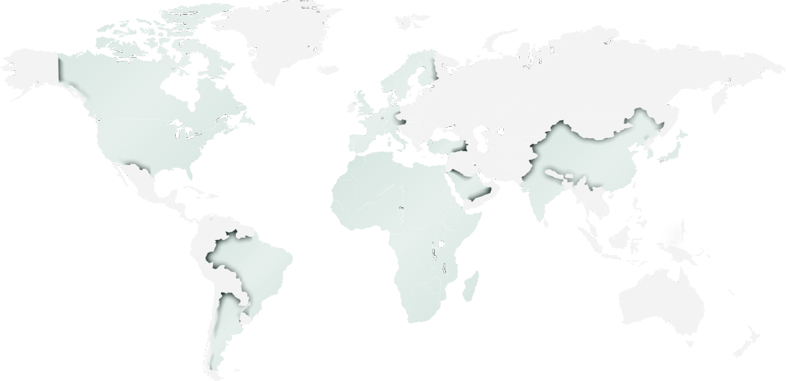
50 years of partnership for the development of Africa
G-7 Shareholding: 28%
Americas
U.S.A. | 6.623%
Canada | 3.876%
Brazil | 0.332%
Argentina | 0.090%
Europe
Germany | 4.157%
France | 3.773%
Italy | 2.438%
U.K. | 1.774%
Sweden | 1.578%
Switzerland | 1.473%
Denmark | 1.182%
Norway | 1.181%
Spain | 1.070%
Netherlands | 0.879%
Belgium | 0.642%
Finland | 0.491%
Austria | 0.449%
Portugal | 0.240%
Luxemboug | 0.202%
Africa
Nigeria | 9.332%
Egypt | 5.622%
South Africa | 5.055%
Algeria | 4.243%
Côte d'Ivoire | 3.738%
Morocco | 3.608%
Libya | 2.652%
Ghana | 2.140%
Zimbabwe | 1.965%
Ethiopia | 1.580%
Kenya | 1.440%
Tunisia | 1.406%
D.R.Congo | 1.293%
Zambia | 1.177%
Angola | 1.168%
Cameroon | 1.082%
Botswana | 1.077%
Senegal | 1.047%
Gabon | 0.997%
Tanzania | 0.762%
Mauritius | 0.653%
Madagascar | 0.649%
Mozambique | 0.622%
Congo | 0.454%
Uganda | 0.450%
Mali | 0.433%
South Sudan | 0.412%
Guinea | 0.403%
Burkina Faso | 0.399%
Namibia | 0.345%
Sudan | 0.309%
Sierra Leone | 0.289%
Malawi | 0.244%
Burundi | 0.238%
Niger | 0.237%
Benin | 0.193%
Liberia | 0.192%
Togo | 0.157%
Gambia,The | 0.152%
Equ.Guinea | 0.146%
Rwanda | 0.132%
Swaziland | 0.114%
Cape Verde | 0.070%
Sao Tome & P. | 0.068%
Chad | 0.066%
Lesotho | 0.057%
Mauritania | 0.057%
Cent.Afr. Rep | 0.042%
Eritrea | 0.031%
Somalia | 0.030%
Seychelles | 0.028%
Guinea Bissau | 0.021%
Strong capitalization
AAA credit strength, our driving force for development
Prudent financial & risk management policies
Middle-East
Kuwait | 0.451%
Turkey | 0.359%
Saudi Arabia | 0.194%
Asia
Excellent liquidity
Preferred creditor status
Extraordinary shareholder support
Japan | 5.518%
China | 1.183%
Korea | 0.483%
India | 0.258%
(As of 31st December 2017)

Slide 3
Resilience to negative shocks
Real Output is up
Foreign Direct Investments
4.1%
Better macroeconomic management
Progress in structural reforms
Sensible policy frameworks
4.1%
2019
3.6%
2018
2017
Stronger economic perspectives
Good GDP growth recovery from 2.2% in 2016
Recovery in commodity prices
Sustained domestic demand
Improvement in agricultural production
Source: African Economic Outlook 2018
Extractive industries, infrastructure, and consumer-oriented industries

Slide 4
Recognizing the primacy of the private sector
70% of investment
75% of economic output
Our Private Sector Strategy
1. Improve Africa’s investment and business climate by helping strengthen the legal and regulatory environment
2. Improve access to social and economic infrastructure
90% of formal and informal employment
3. Foster enterprise development through improving access to finance, addressing value chain’s gap and skills shortages
Priority areas
Support the elaboration of industrial policies
Build financial systems to ease access to finance
Invest into sustainable agriculture and agroindustry, clean energy, transport, logistics and manufacturing
Challenges
Business and regulatory environment
Access to medium and long term finance
Inadequate infrastructure
3

Slide 5
Some private sector projects
Kenya - Lake Turkana Wind Power Project
Rwanda – Kigali Bulk Water Supply Project
Project cost : EUR 625 million
AfDB Financing: EUR 115 million
“African Renewable Deal of the Year 2015” award by Thomson Reuters Project Finance International
Project cost : USD 79.1 million
AfDB Financing: USD 20 million
Project Description:
Construction of 300 MW wind farm, comprising of 365 turbines of 850 KW capacity, connected to the power grid
Expected outcomes:
Scale up energy generation to 5,000 MW
Produce 20% of Kenya’s currently installed capacity, closing the energy gap of the country
GHG emissions reduction of 700,000 tons of CO2 per year
Project Description:
Design, build, operate and maintain a 40,000m3/day Bulk Water Facility, south of Kigali
Expected outcomes:
Provide clean potable water and improving public health
One of the first large-scale water supply PPP in Sub Saharan Africa
“Best deal of the Year in Africa” award by Euromoney Award
Multinational – Nacala Rail and Port Project
Mali - Segou Solar Photovoltaic Power Plant Project
Project cost : USD 4,597 million
AfDB Financing: USD 300 million
Project cost: EUR 49 million
AfDB financing: EUR 8 million
Computer generated mockup of the Lake Turkana project
Project Description:
Support the construction/rehabilitation of railway and associated port infrastructure from Mozambique to Malawi
Expected outcomes:
Creation of 1,500 jobs during construction
Facilitate trade and development across the region
CO2 emission reduction
Project Description:
Design, construction and operations of the first large-scale solar photovoltaic plant in Mali.
Expected outcomes:
Expected to add 33 MW to the installed power generation capacity of about 528 MW
55,000 equivalent tons of CO2 avoided each year
Produce enough power for approximately 60,000 households

Slide 6
Positioning the Bank as the leading arranger of Africa’s syndicated co-financing
ESKOM
USD 965 million
AB/ Loan structures to crowd-in private sector investment
A-Loan
USD 365m (in ZAR) sovereign loan
USD 10m private sector loan
B-Loan
Bank of China USD 150m
BTMU USD 150m
Caixa Bank USD 100m
Citi USD 50m
HSBC USD 100m
JPMorgan USD 115m
KFW-Ipex Bank USD 100m
Siemens Financial USD 50m
Standard Chartered Bank USD 150m
Largest syndicated loan in Africa
Preferred Creditor Status to benefit commercial lenders

Slide 7
Partial Risk Guarantee, an innovative political risk mitigation instrument
PRGs extended by the Bank for
Government Benefits
Private Sector Benefits
Sovereign governments and sovereign-owned entities with the Bank signing a counter-guarantee with the respective governments
Leverages country
borrowing program
Mitigates some
lending risks
Risk sharing with private sector
Improves a project’s financial viability
To protect private lenders against…
Facilitates privatizations
and PPPs
Project benefits from Bank’s safeguards
Inability to repatriate or convert currency earned in the country
Confiscation, expropriation, nationalization and deprivation
Project benefits from Bank’s safeguards
Reinforces government undertakings
Not honoring contractual obligations
Changes in law and force majeure risks
No additional contingent liability to the country
Provides lender confidence to invest

Slide 8
Partial Credit Guarantees, to attract financing for Africa’s transformation
PCGs extended by AfDB for
To protect against
For the benefit of
Eligible Regional Member Countries
Sovereign owned entities
Private sector project sponsors
that meet the Bank’s due diligence criteria for loans
Debt service defaults, including both
Political risk
Availability of foreign exchange and convertibility into foreign exchange
Expropriation and nationalization
Contractual obligations
Changes in law
Commercial risks such as demand risk, market risks, etc.
Private lenders to both private sector clients and/or sovereign clients
Bondholders of both public and corporate debt

Slide 9
Africa’s premier investment market place
AfDB estimates investment needs for infrastructure in the range of USD 130–170 billion a year
A totally transactional opportunity for investors
Bringing together AfDB and global multilateral financial institutions to de-risk investments at scale
Leverage investments strategically in Africa
Catalyze investments into projects to help the High 5s agenda
Scaling up project preparation facilities and tools
Addressing policy and regulatory issues
Promoting projects for co-investments and blended finance
Providing effective risk-mitigation instruments (creation of a co-guarantee platform)
November 7-9, 2018
Johannesburg, South Africa
Private sector: banks, insurance companies, private equity and venture capital firms, impact investors, pension funds, project developers
Government officials: Heads of State and Government, Ministers of Finance, Central Bank Governors, Sovereign Wealth Funds
Multilateral development finance institutions
Targeted investors
Discussions to focus on
Global pension funds
Sovereign Wealth Funds
Institutional investors
Develop and structure deals
Promote deals
Close deals and execute deals

Slide 10
African Development Bank, your financing partner
V
V
V
Significant footprint and extensive experience
Deep understanding of the challenges of the continent
Preferred Creditor Status
V
V
Better positioned to address risk allocation among both the Borrower and the Foreign Sponsor / Investor
Closer to clients
9

